Slide 1

Memcomb
Noah Bradley, Bryce Waters, Isaac Watson, Jizhou Zhang, Andrew Dever, Kyle King

Slide 2
Memcomb
For those who want to share and connect through similar memories in their lives. The Memcomb application is a social media platform that allows users to upload photos, videos, and audio, with an attached caption, that displays an important event in their lives. Unlike similar applications, Memcomb will connect users who share events of a similar time and place, allowing those users to discover each other. Our product provides a new way for users to interact with one another.

Slide 3
This Sprint
Establish the definition of a ‘memory’
Research timeline
Researching Database options
Create new SQL database
Move database to Google Cloud Server / Connect to web app
Add views for: timeline, account management, etc.
Role assignment and Access control rules
Password modification / Forgotten functionality
User management (Creation / Deletion / Update / Search)
Designed Profile Template Component

Slide 4
What is a ‘Memory’
In the context of Memcomb, the term memory is a catch-all to describe anything a user uploads with the intention of sharing and connecting with others over.
Memories will have locations, as well as dates, and can be tagged with random keywords.
Memories can also have several different data types, including text posts, audio files, or images.

Slide 5
Challenges and Risks
Repository issues
Roslyn
Web Grease
Database
Google Cloud Port Forwarding
Connecting to Visual Studio
NoSQL vs MySQL
Homepage/Timeline Algorithm
How we want to display and organize the timeline
How our database will affect the timeline
Profile page
How the page should look and being able configure CSS to the page
Implementing code functions for profile picture content

Slide 6
Mitigation Plan
Tutorial / Error Help Doc
Repo issues are tedious but a learning process, we are storing up stackoverflow solutions
No error will stop us
Timeline Algo is simplistic, chronological order is what we expect to use
How we store the information will be determined by the database

Slide 7
Database
We originally created a simple schema for a relational database, but after some research we are considering a NoSQL database instead
MySQL databases are a type of relational database, where data is stored in tables and have relational properties with other data
NoSQL databases are a type of object-oriented database, where data is less organized but is treated as objects and easier to manipulate
Facebook uses MongoDB, which is a NoSQL database, but Twitter, Instagram and Youtube all use various SQL databases

Slide 8
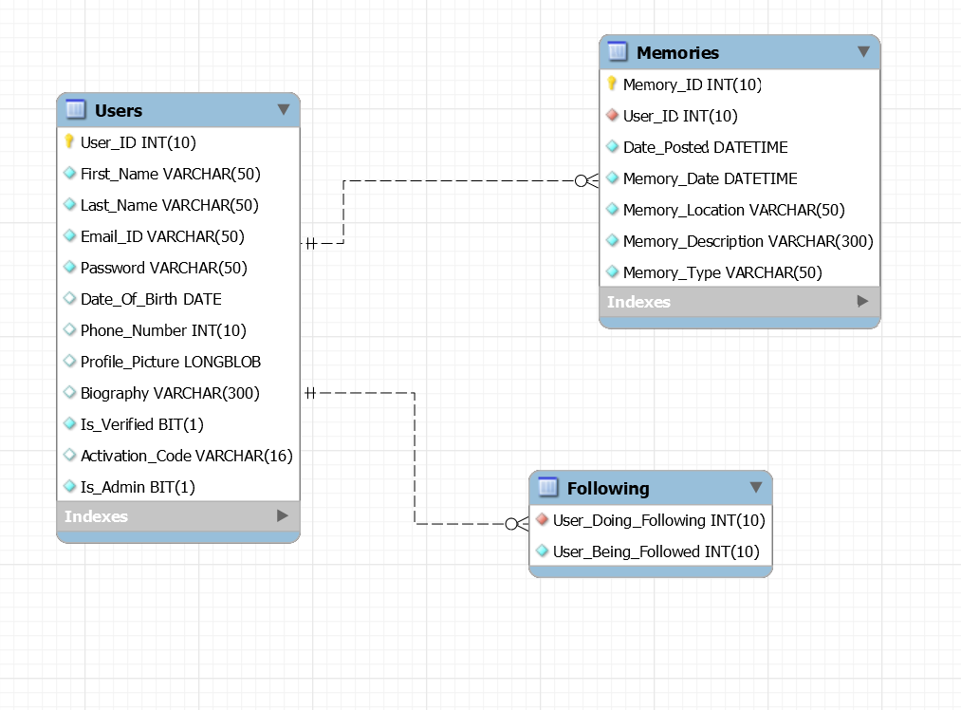
Current EERD

Slide 9
User Stories
Last Sprint
As a user I want to be able to sign up for memcomb with an email address and password
This Sprint
As a user I need to be able to view my profile
Next Sprint
As a user I need to be able to view my timeline when I log into my account

Slide 10
Next Sprint Objectives
Implement test cases
Merge UI with Database
Homepage / Profile Page
Research and implement Middleware

Slide 11
